Slide 1
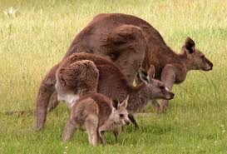
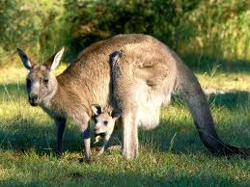
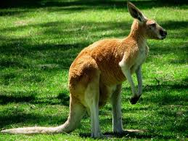
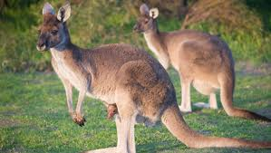
Kangaroos
By Lily Blum

Slide 2
Table of Contents
Habitat Sweet Habitat…………..page 2
Eye of the Tiger…………….page 4
Kangarooistics……………page 6
The Circle of Life………..page 8
Secret Life………….page 10
Conclusion……………page 12
Glossary……………page 14
Resources…………page 16

Slide 3
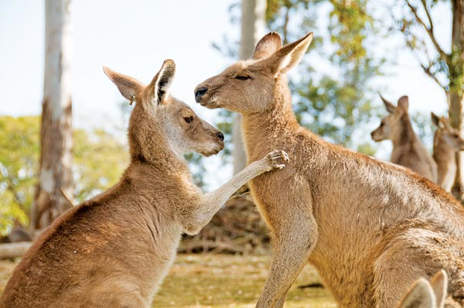
Habitat Sweet Habitat
If kangaroos and dogs stick they’re tongues out to stay cool why can’t we? Kangaroos live in Australia and parts of Africa and Asia. Kangaroos live with different animals like Wallaby’s, Wallaroos, Quokka’s, and Dorcopsis’s. Also kangaroos can survive in extreme heat by sticking they’re tongues out like dogs. Finally kangaroos live on flat land and some prefer hills.
This is two kangaroos in their natural habitat saying hello.

Slide 4
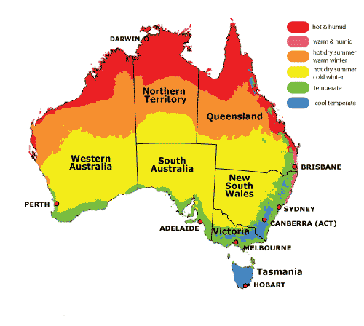
Map of where kangaroos live

Slide 5
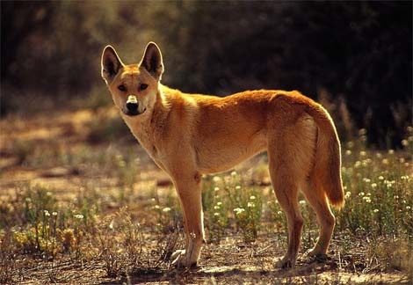
Eye of the Tiger
Eye of the tiger, wait what about the eye of the kangaroo? First kangaroos have to survive in extreme heat and really dry land. Next they mostly eat plants like shrubs, and grass. Also kangaroos only hunt dingoes if they really need it. Kangaroos don’t hunt that often so this means that kangaroos are herbivores this means they eat plants. To find water they dig holes, drink water from plants, if they can’t find rivens. Lastly sniffing is a common social gesture for kangaroos
This is a dingo searching for it’s prey the kangaroo

Slide 6
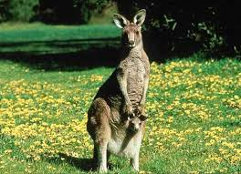
Kangarooistics
“ Yipe, yipe” “shhh” this is the sound of a kangaroo. The colors of kangaroos are like earth tones so they can blend in like red, light brown, and brown. Kangaroos make very little noises like grunts, very small barks, and coughing noises. Kangaroos have marsupial bones they hold the walls of the pouch with out it joeys can’t stay in there. Most people think kangaroos are all about fighting but they can be gentle or timid. Kangaroos can weigh up to 200 pounds and can stand taller then a 6 foot man.
This picture shows kangaroos stand taller than a six foot man

Slide 7
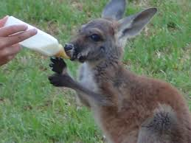
The Circle of Life
OMG! That kangaroo has a cute little Joey! The baby kangaroo has to pull it’s way from the birth canal to the pouch. Then bommers of the mobs have access to mate with any female in the mob. Wild kangaroos live to 7 years old, some larger kangaroos live up to 20 years old. Also kangaroos have been around for 40-70,000 years. Baby kangaroos are called baby Joey’s.

Slide 8
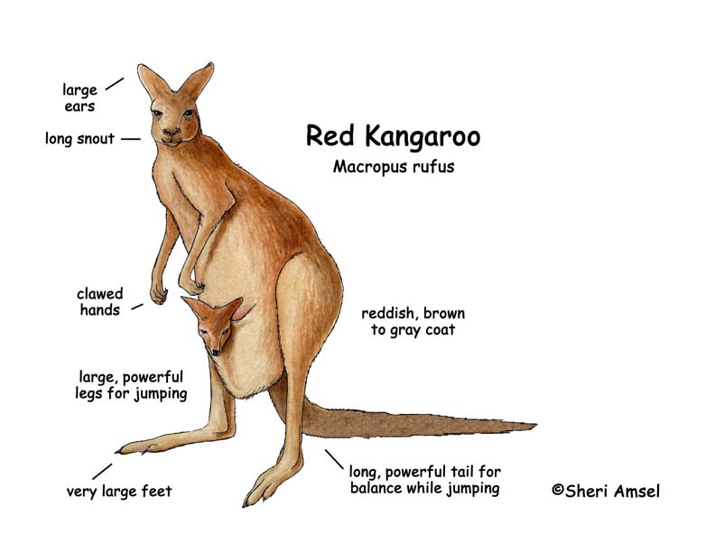
Diagram

Slide 9
Secret Life
“Oh man” that is a new species of kangaroo. There are 62 and more types of kangaroos. Even though there are 62 types there are only 60 different species. Kangaroos have roles such as, male kangaroos are called bommer’s, and females are called flyers. Kangaroos live in groups called mobs. Kangaroos are related to Quokka’s, banded-hare wallaby’s, and the musky rat kangaroos.

Slide 10
Fun Facts
Kangaroos have a secret code of language.
Kangaroos had to box against men in the early 1900s.
Kangaroos are apart of the marsupial family.

Slide 11
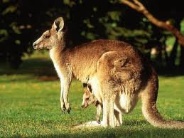
Conclusion
As you see kangaroos can be interesting if they kept fighting boxers in the 1900’s they could be extinct. Some people still fight kangaroos but they are held captive while wild kangaroo are hopping freely in the wild.

Slide 12
Glossary
Bommer- A male kangaroo that can make booming sounds.
Flyer- Is a female kangaroos simple nickname
Mobs- A group of kangaroos
Marsupial- A mammal that is incomplete at birth
Quokka- A small, short tailed wallaby
Dorcopsis- A genus marsupial
Canal- A tubular duct in a animal
Dingoes- A wild domesticated dog
Wallaby- An Australian marsupial
Mate- A pair of animals

Slide 13
Resources
I got my info from
The book KANGAROOS
Google.com
Answers.com
And the song eye of the tiger

Slide 14
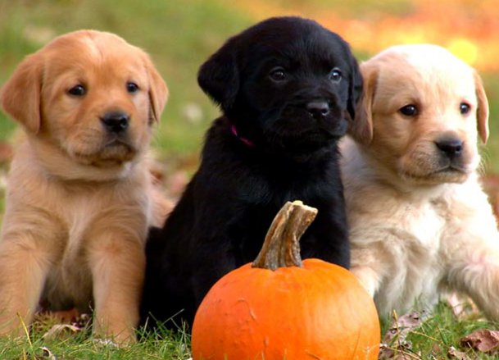
About the Author
My name is Lily Blum I live in Keansburg, NJ my favorite video game is Pokemon. I love every animal so it was hard to pick just one to write about. My favorite singer is Justin Bieber. I have two brothers Gene and Austin.

